Slide 1

Strömungssimulation auf GPUs

Slide 2

Outline
Problem statement
Requirement of GPU
GPU acceleration
Solution approach
Comparison between CPU and GPU execution.
Benchmarks of the program
Observations from results

Slide 3
Problem statement
The task is to accelerate the computations of the N-Body problem using GPU & OMP technologies
n-Body problem
predicting the individual motions of group of objects interacting with each other in a bounded system as shown in the figure.
[2]
In our case, we have considered vortex elements in a fluid as an n-body problem. By using CUDA technology, we can accelerate the computation.

Slide 4
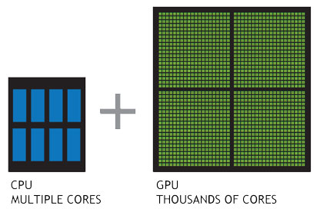
Requirement of GPUs
In the modern world, there are very powerful CPUs but still there is a requirement of GPU to execute or run a program.
CPU Vs GPU
CPU | GPU
Designed for a wide variety of applications. | Designed specifically for rendering and other graphic applications
Consists of few cores optimized for sequential serial processing | Massively parallel architecture consisting of thousands of smaller cores
[1]

Slide 5
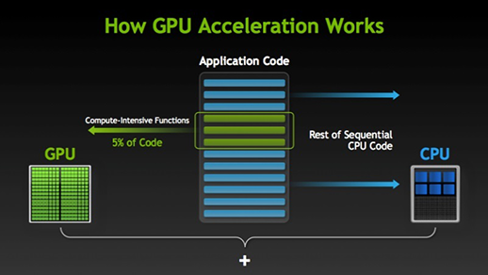
GPU acceleration
[1]

Slide 6


Solution approach
Identify the intensive loops.
Identify the parameters need to be passed to kernel.
Initialize pointers and allocate the parameters with appropriate size.
Linearize 2D array in to 1D array while assigning to pointers.
Copy the parameters values to GPU using ‘cudaMemcpyHostToDevice’.

Slide 7


Solution approach(continued..)
Design a __global__ function to run the block of code in GPU.
Call the designed __global__ function from host(CPU).
Copy the values of parameters from device to host using ‘cudaMemcpyDeviceToHost’.
At the end of the program, allocated memory in GPU must be freed by using ‘cudaFree(ptr)’ function.

Slide 8
Solution approach(continued..)
A single GPU can have X number of blocks and each block can have Y number of threads.
Block
Number of blocks and threads can be configured by giving numerical values in between 3 angular brackets ‘<<<X,Y>>>’. In our case, it is <<<Number/32,32>>> Number=1000
Number of blocks ~ 31
Number of threads =32
T0 | T1 | T2 | T3
T4 | T5 | T6 | T7
T8 | T9 | T10 | T11
T12 | T13 | T14 | T15
Number of parallel operations initiated is X*Y=Number/32 * 32=1000

Slide 9



Sequential CPU Vs Parallel CPU Vs Parallel GPU
Processor :Intel(R) Core(TM) i7-6700HQ
No”of cores = 4
No” of threads=8
Processor Base Frequency = 2.64 GHz
GPU :NVIDIA GEFORCE GTX 950M
Cuda cores = 640
Memory Clock frequency =1000 MHz
Cuda support = Yes
Execution with CPU (Sequentially)
Execution with CPU (parallel)
1.354 times faster than sequential code
Execution with GPU acceleration(parallel)
3.96 times faster than sequential code

Slide 10

Benchmarks by using the Neptune1 cluster
To observe the execution time with different hardware configurations, we have implemented the same code in provided Neptune1 cluster.
Execution with GPU acceleration(parallel)

Slide 11
Observations from the results
Execution time with GPU acceleration is far lesser than sequential CPU execution. This is due to the availability of more cores in GPU.
Selection of number of blocks and threads must be done by keeping hardware configuration in mind.
Limitations:
GPU cores are not as much powerful as CPU cores.
Size of parameters passing while calling global function is limited.

Slide 12
References
[1] http://www.nvidia.com/object/what-is-gpu-computing.html
[2] https://en.wikipedia.org/wiki/N-body_problem
[3] http://adams.dm.unipi.it/~gronchi/nbody/nonsimple
[4] https://developer.nvidia.com/cuda-education

Slide 13
Thank You

